Slide 1


SAP UI5 & FIORI with OData TRAINING
Anubhav Oberoy
Day – 17

Slide 2

Agenda – Day 17
Types of Fiori Apps
Understanding Data Model
Creating Fiori App uisng Template in BAS
Creating Fiori App uisng Template in VS Code
Fiori UX Consistency
Introduciton to Fiori Elements
Free Style v/s Fiori Elements Apps
Developer Persona – Fiori Elements
Introduction to Annotaions.
List Report Application – Fiori Element
Analytic List Page – Fiori Element

Slide 3

Types of Fiori Apps
SAP UI5 and Fiori Development
ABAP on HANA Cum S.4HANA CDS
Fiori Advance and Security
Types of Fiori Apps
Fiori Elements
Transactional Fiori Apps
Fact Sheet / Smart Filter
Analytical Fiori Apps
Free Style Fiori App
Display Data in Smart table
Query Browser Tile
Master Details
SAP Analytic List Page
Overview Pages
Worklist
There 2 ways to create these apps
Using CDS View based annotations
SAP BAS/VS Code annotation Editor
KPI Modeler
BOPF Based Apps
(CDS view)
Free Style Analytic App
www.anubhavtrainings.com

Slide 4

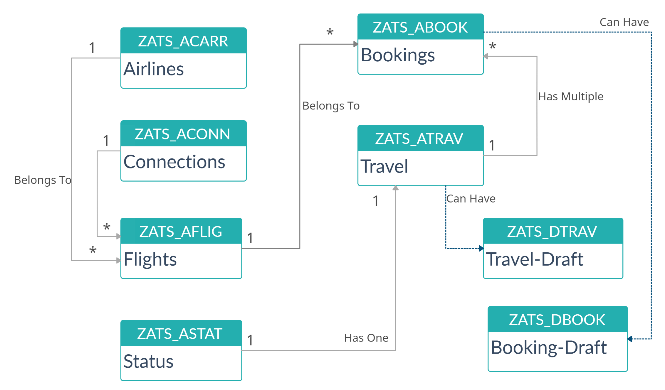
Data Model
www.anubhavtrainings.com

Slide 5
Fiori = UX Consistency
UX consistency
▪ Increases adoption of your app
▪ Improves business user productivity
▪ Decreases training time
▪ Improves data quality
▪ Enhances user satisfaction
SAP Fiori elements provides standard floorplans and uses metadata to streamline and accelerate developing SAPUI5 applications.
SAP Fiori elements
▪ Delivers enterprise-ready SAPUI5 apps based on
stable, optimized, out-of-the-box UI code
▪ Boosts developer efficiency by scaling development
and maintenance in a cost-efficient way
▪ Provides a centrally managed, consistent UX
complying with the latest SAP Fiori design
▪ Ensures upgrade stability and forward compatibility
▪ Allows extensibility of standard floorplans with custom
controls and logic

Slide 6
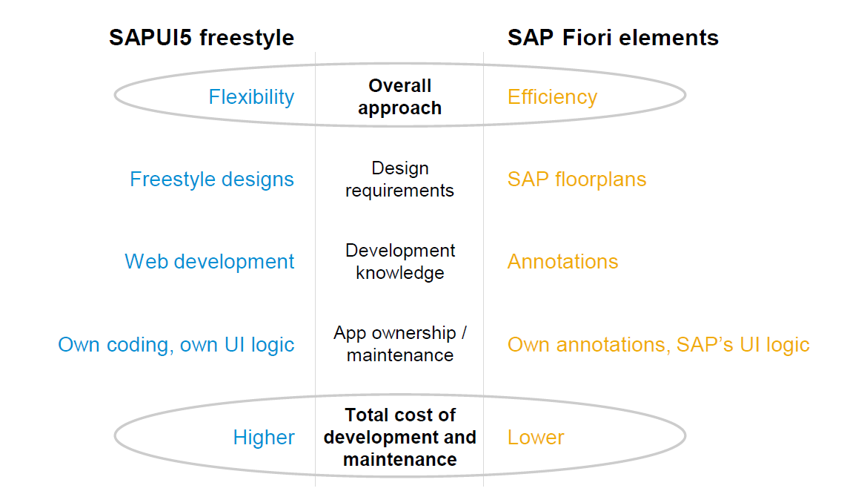
Free Style v/s Fiori Elements Apps

Slide 7
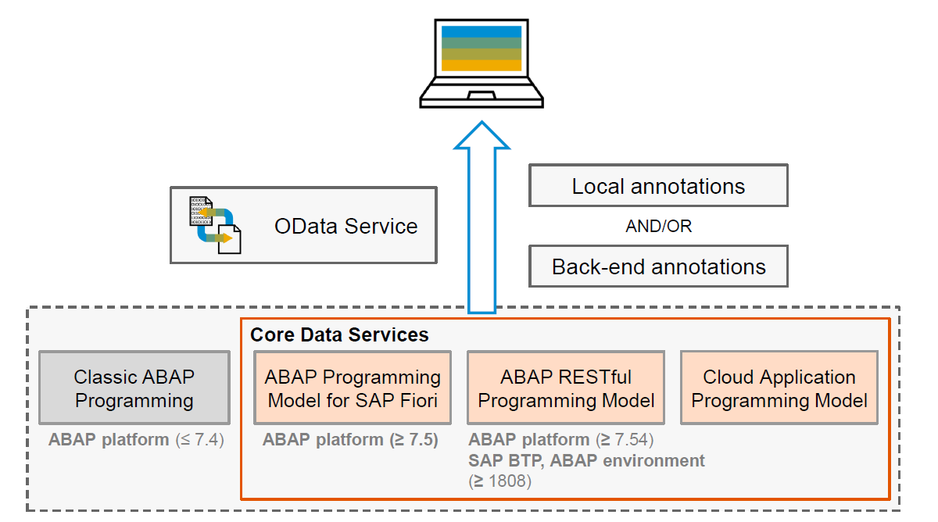
Big Picture – Architecture

Slide 8
Annotations
Annotations are additional metadata and provide abstract definitions of data semantics. These abstract definitions are stored in vocabularies from OData and SAP. SAP Fiori elements understand the annotations and generates the UI based on them.
CDS View Annotations
XML Annotations
Annotations which are coding in ABAP system.
Require experience in ABAP on HANA and done by an ABAP or S/4HANA Consultants
CDS annotations follow the lifecycle of your OData
Service.
Due to different release cycles, some new annotations
might be available later in ABAP CDS.
More suitable if we use frameworks like RAP, & BOPF to build end to end applications
Project will be coupled with OData built on CDS hence we cannot test application if the service is down.
Easy to code and can be modularized with metadata extensions in CDS.
Use ADT tool to code the same.
Coded inside the annotations.xml file inside a Fiori Application
Require understanding of XML in general and knowledge of annotations
XML annotations follow the lifecycle of your app (local project)
With latest UI5 release, we can use new features
Suitable if we use SEGW based services, Or other frameworks which does not support the annotations.
UI projects are decoupled from the CDS and services and can be tested and transported independently.
Easy to work with the help of annotation modeler extension pack
Use BAS or VS Code to develop same.

Slide 9
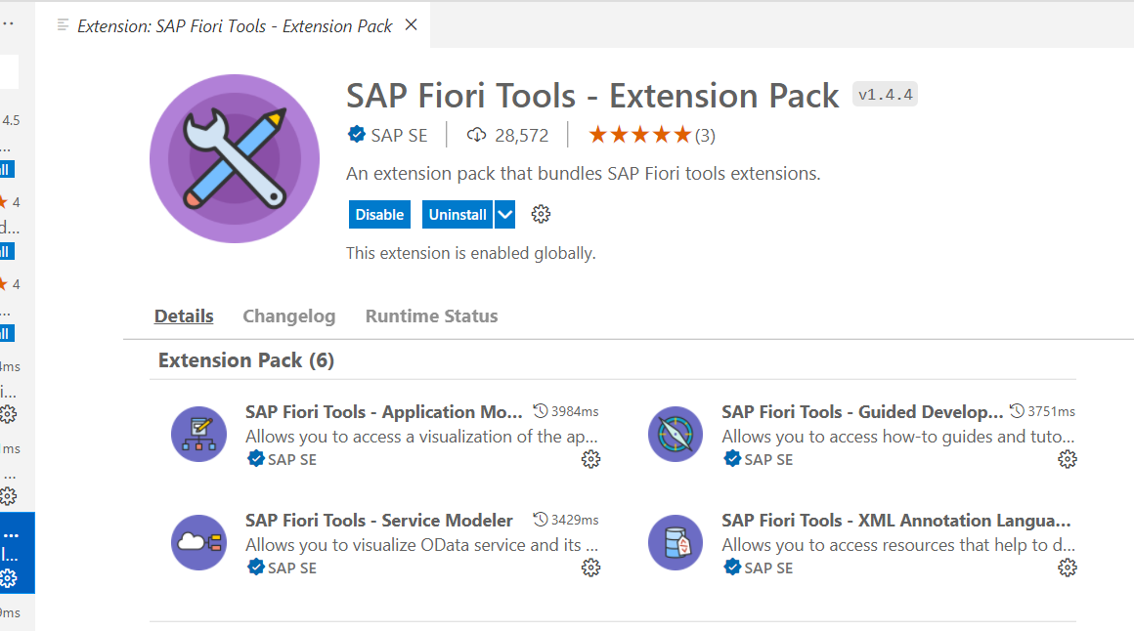
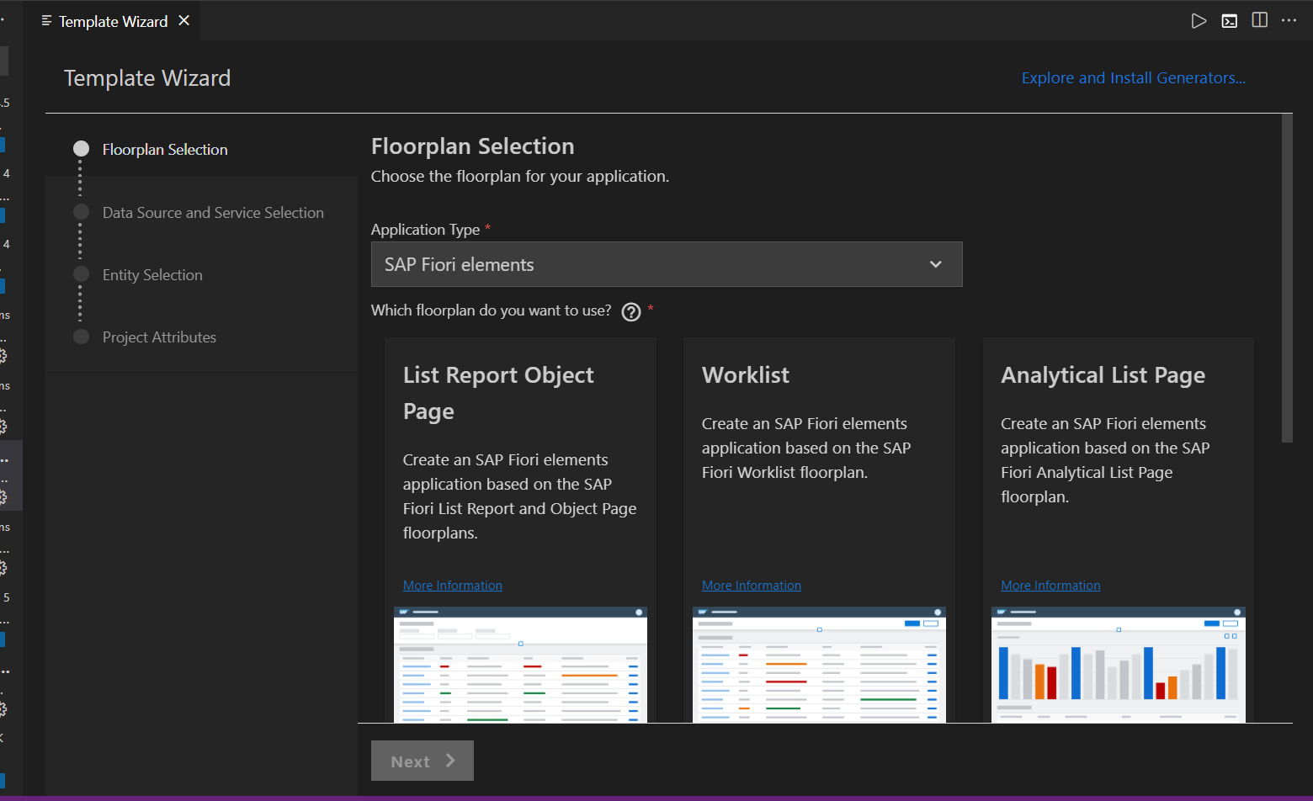
Creating Fiori App using Template in VS code
Before we start generating application in VS code, we need to verify that Fiori Tools are installed in our system or not. To do that we need to install an extension pack in VS code, which is SAP Fiori Tools – Extension Pack.
Once the installation of extension pack is completed, we can follow the same steps which are specified in the previous slide. In which we have generated the application using template in BAS.
When we open the Template Wizard in VS Code then, we will see a similar screen which we have seen in the BAS.

Slide 10
Fiori Elements - List Report Application
The list report offers powerful features for finding and acting on relevant data sets. It is often used as an entry point for navigating to the item details, which are usually shown on an object page.
List Report
Object Page

Slide 11
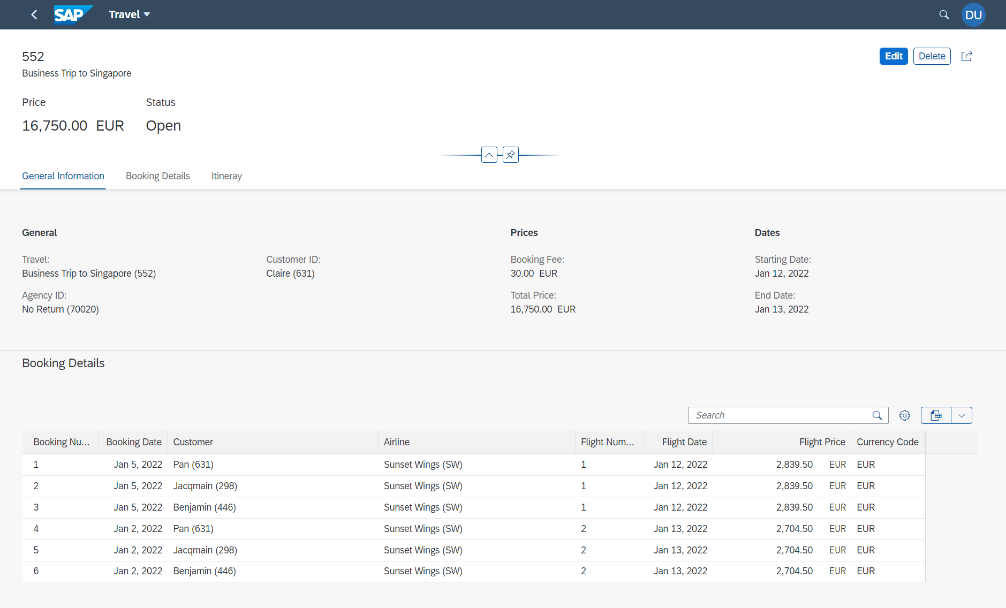
Components of an Object Page
www.anubhavtrainings.com

Slide 12
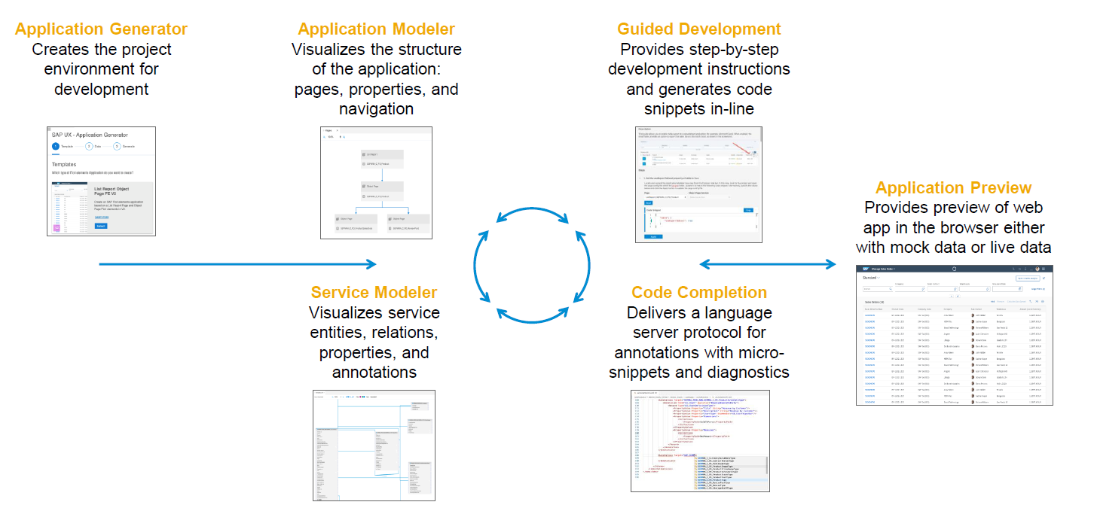
Fiori Extension Pack in VS Code
www.anubhavtrainings.com

Slide 13

End of Day 17

Slide 14

Questions

Slide 15

Anubhav Oberoy

Slide 16


We’re committed to empower you to be
Most Desirable Resource
through powerful training solutions.
We build the workforce of the future.
250+
Corporate Clients
30,000+
Learners Trained
25000+
Learners Placed
FREE WEBINARS
Sign up for free webinars with industry experts every fortnight!
Enroll Now!
Contact us today!
https://anubhavtrainings.com/

Slide 17




More from AnubhavTrainings.com

Slide 18
Title
Content

